Slide 1
SQL Advanced Topics
Manpreet S. Katari

Slide 2
Outline
User variables
SQL Routines
SQL Triggers
NO SQL
https://orion.bio.nyu.edu/phpmyadmin/
Username: ga1009
Passworrd: mkatari@nyu

Slide 3

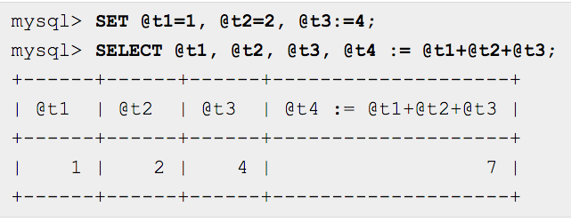
Setting and Selecting variables
In select statements, you have to assign using := because = by itself is a comparison in select statements.
http://dev.mysql.com/doc/refman/5.7/en/user-variables.html

Slide 4
SQL Routines
There are two main types of Routines:
Procedures
Functions
Procedures
A procedure is executed using a CALL function and only return the output value
Function
Just like functions in programming languages, can be called from any part of the code or statement.

Slide 5
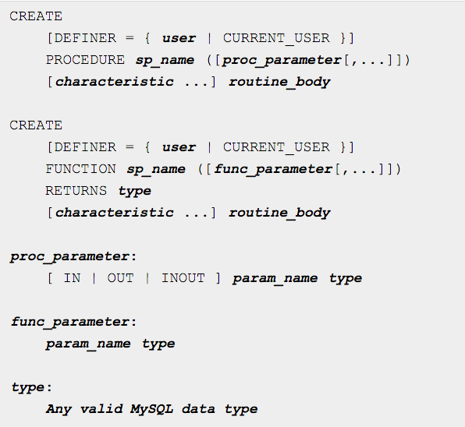
http://dev.mysql.com/doc/refman/5.0/en/create-procedure.html

Slide 6
Procedure Example
DROP PROCEDURE `feature_nrows`;
CREATE DEFINER=`msk8`@`%` PROCEDURE `feature_nrows`(OUT `nrow` INT(255) UNSIGNED) NOT DETERMINISTIC NO SQL SQL SECURITY DEFINER
BEGIN
SELECT COUNT(*) INTO nrow FROM feature;
END

Slide 7
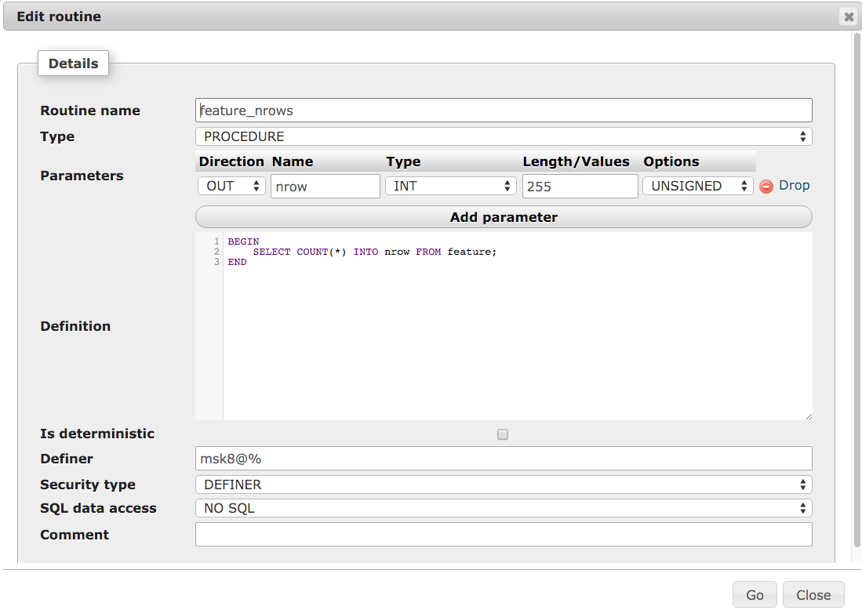

Slide 8
Function Example
DROP FUNCTION `gene_chr`;
CREATE DEFINER=`msk8`@`%` FUNCTION `gene_chr`(`genename` VARCHAR(255)) RETURNS VARCHAR(255) NOT DETERMINISTIC NO SQL SQL SECURITY DEFINER
BEGIN
DECLARE chromosome VARCHAR(255);
select seqname into chromosome from locationlist, feature, name
where locationlist.id = feature.seqid and name.id = feature.id
and name.name = genename; return (chromosome);
END

Slide 9
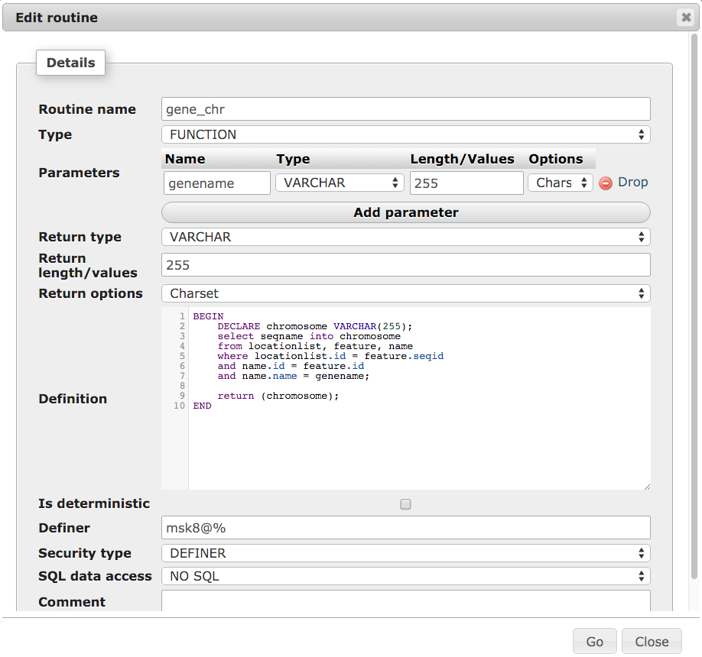

Slide 10
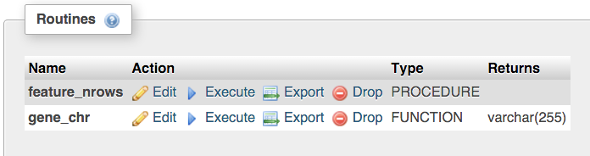
To run the routines, simply click on execute

Slide 11
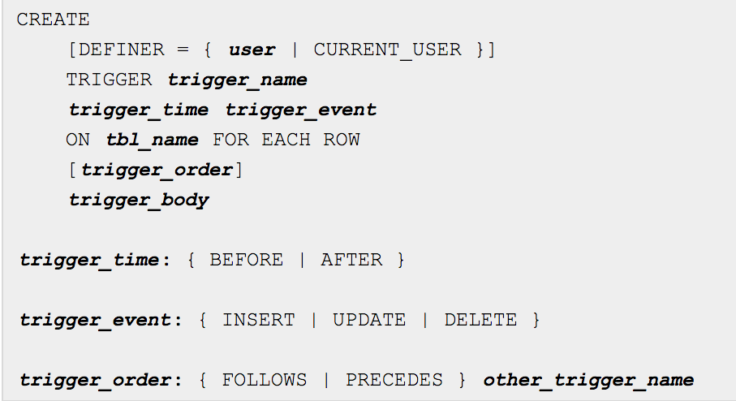
Creating triggers
http://dev.mysql.com/doc/refman/5.7/en/create-trigger.html

Slide 12
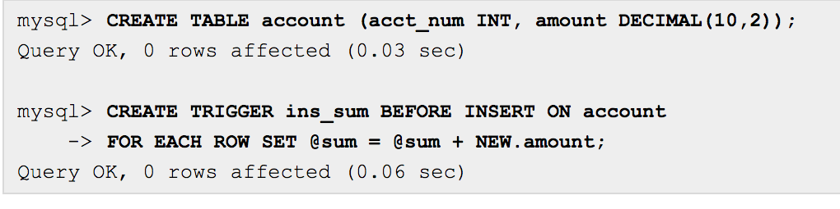
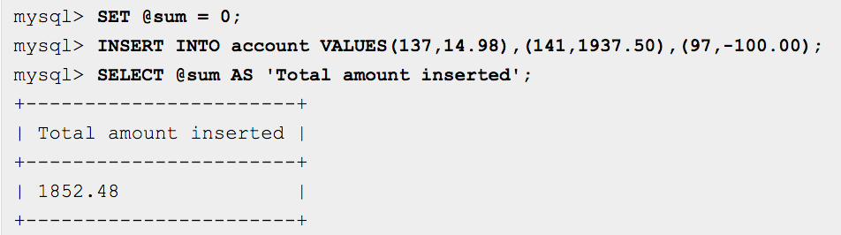
Example use case of trigger
http://dev.mysql.com/doc/refman/5.7/en/trigger-syntax.html

Slide 13
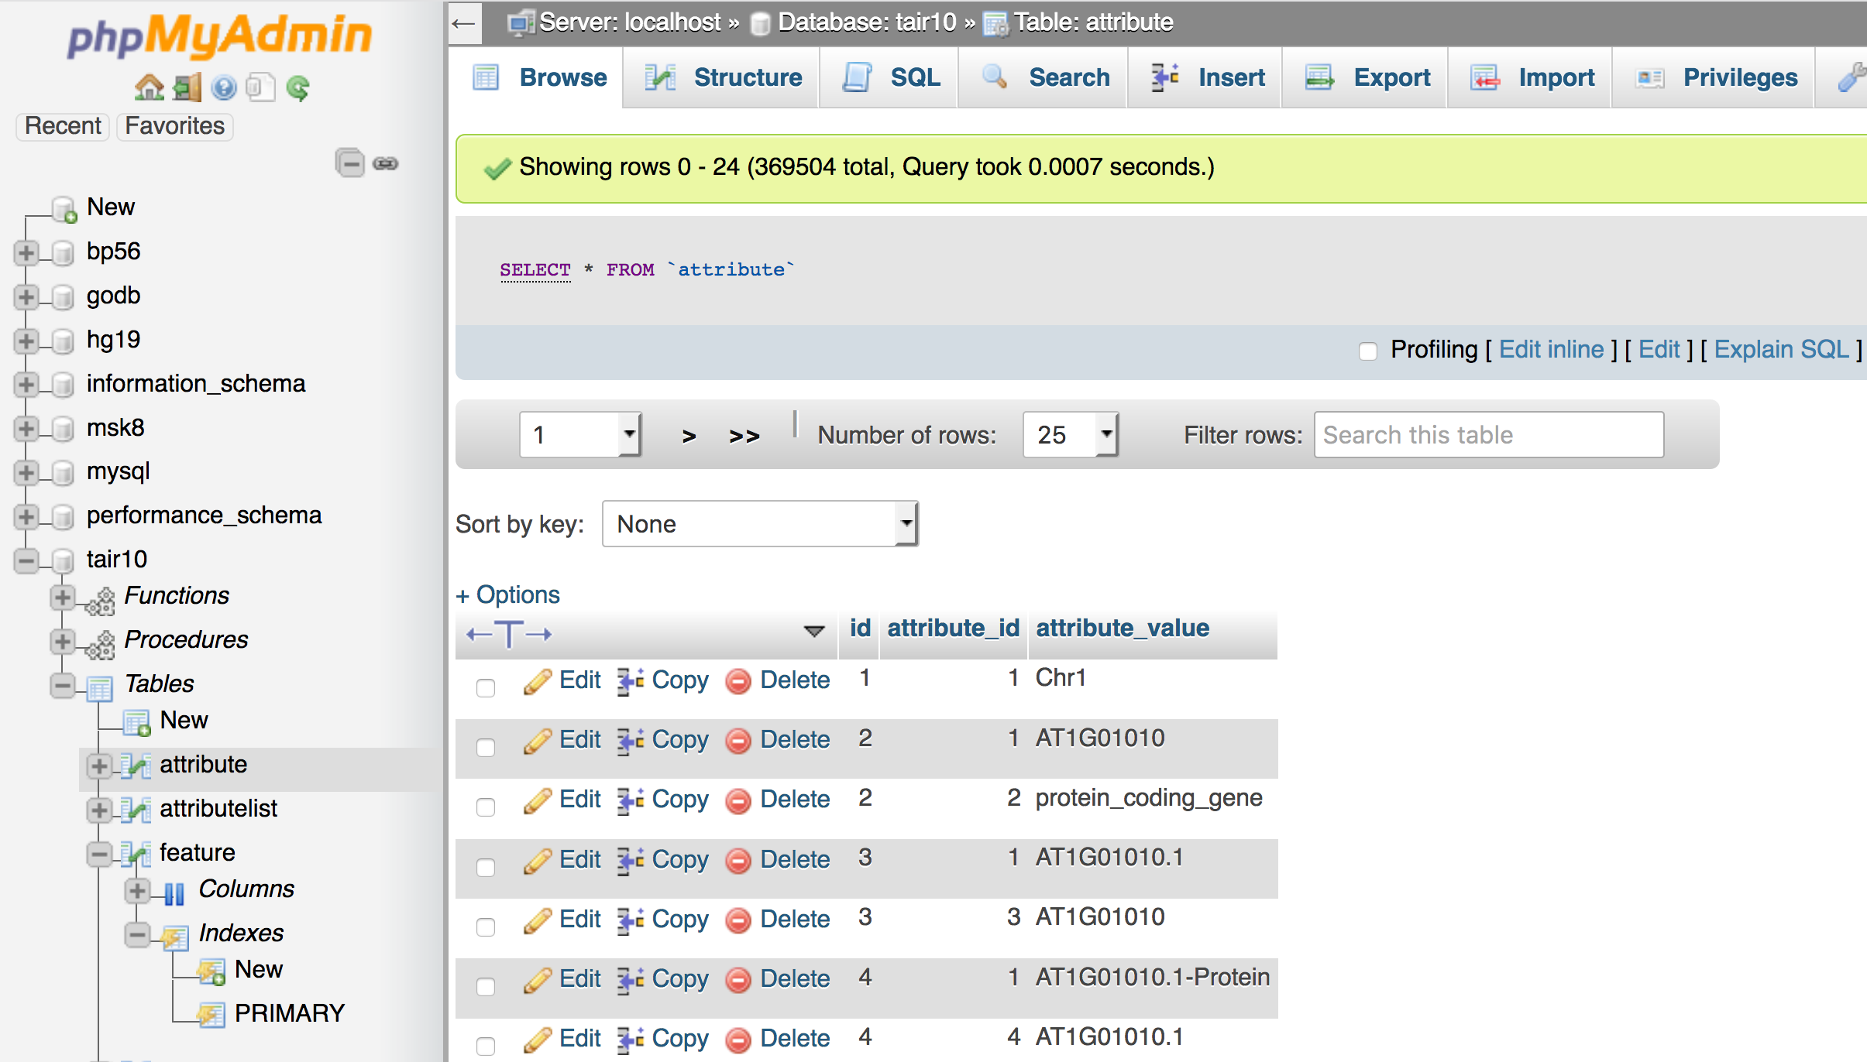

Slide 14
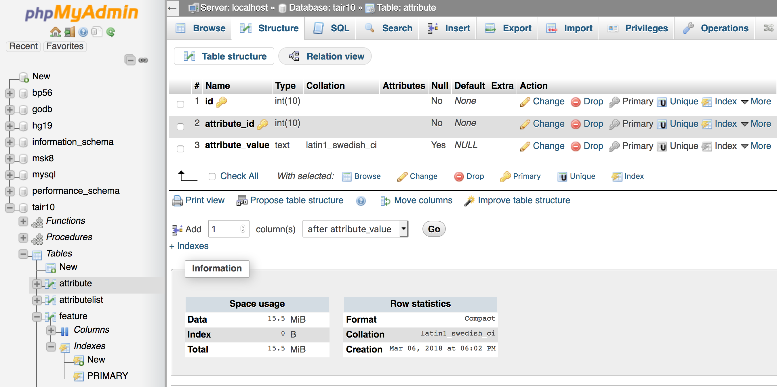

Slide 15
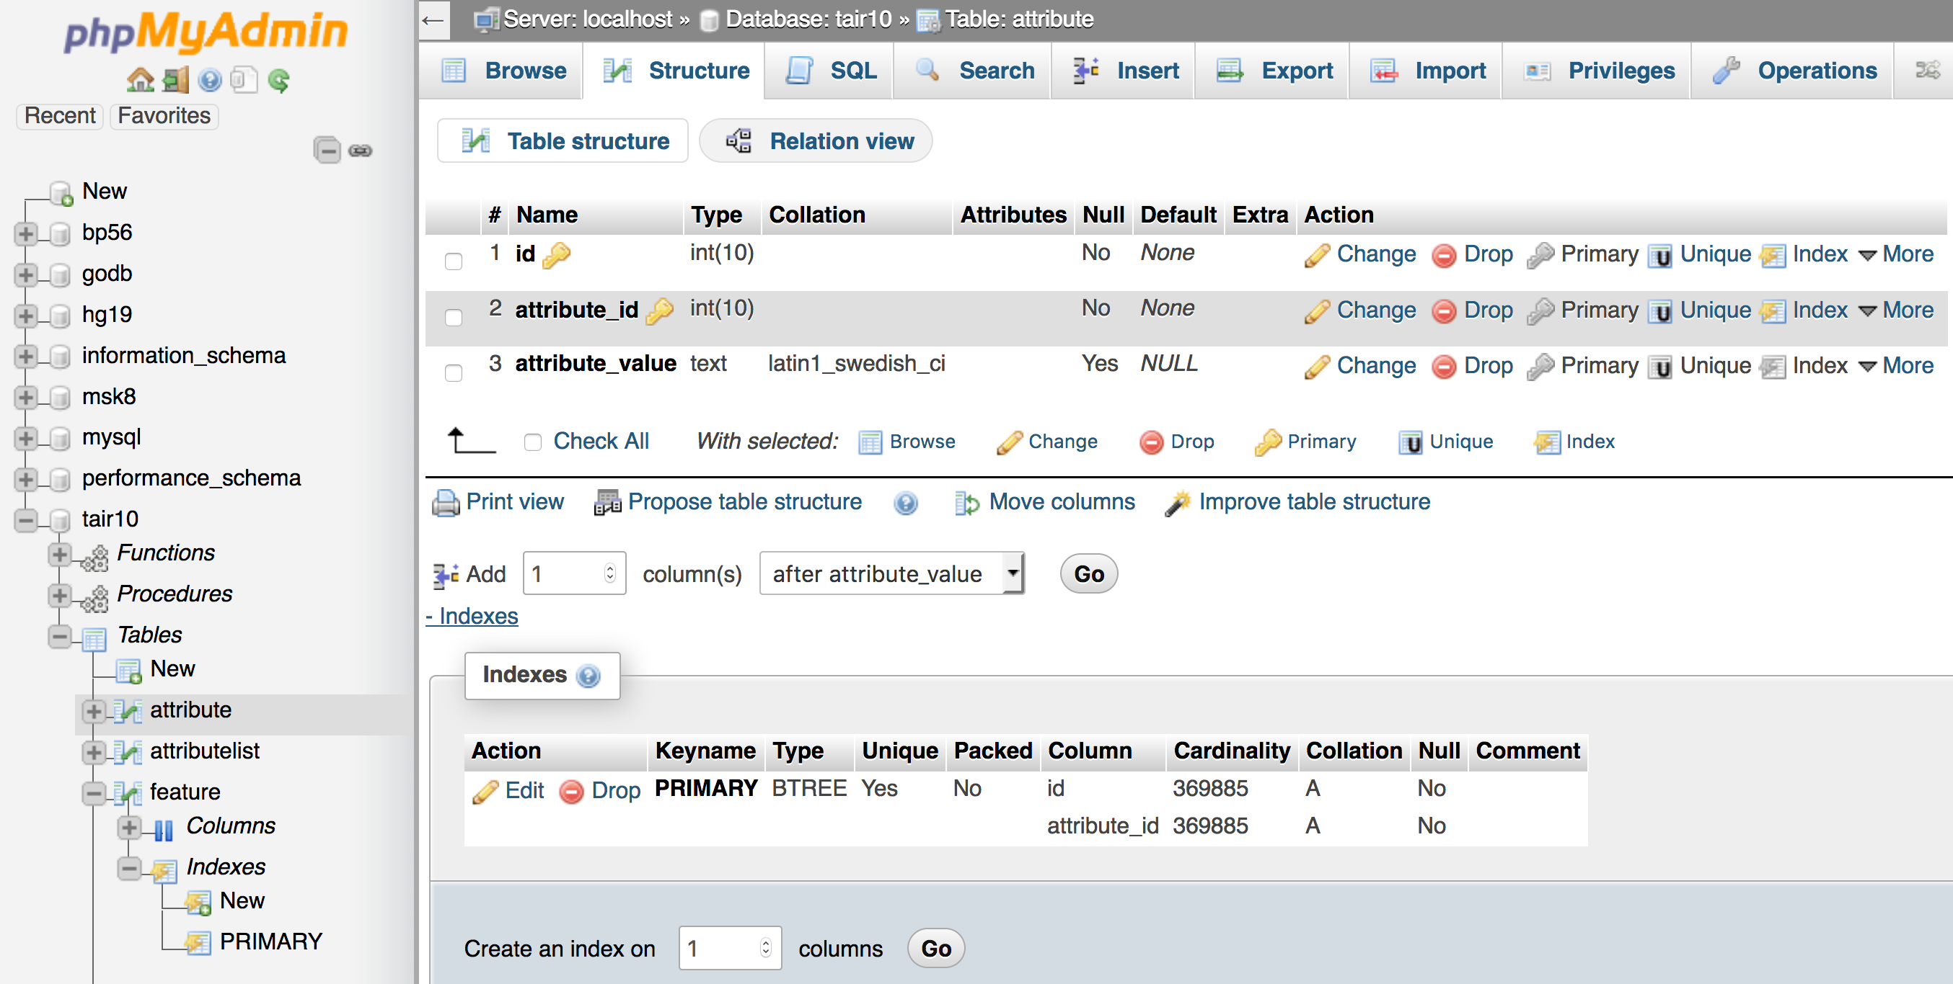

Slide 16
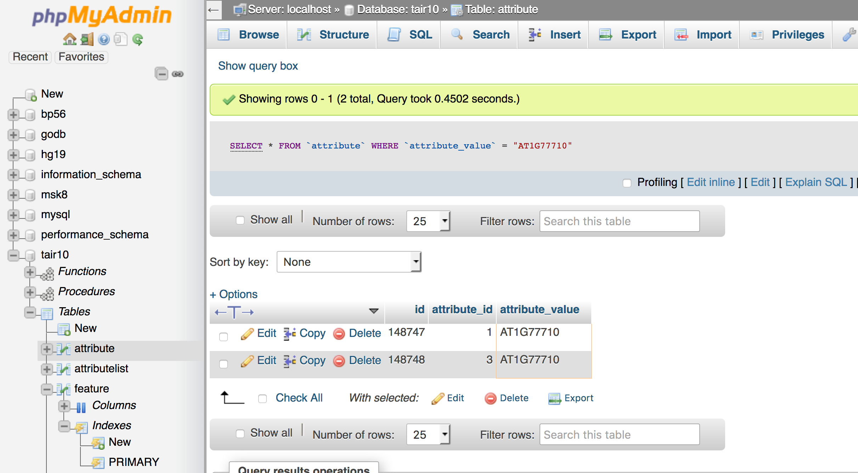

Slide 17
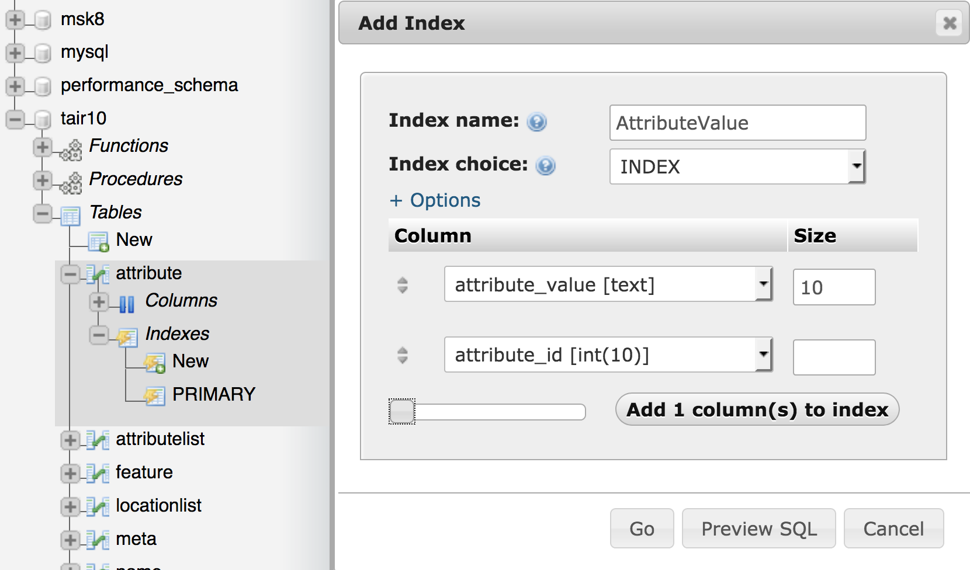

Slide 18
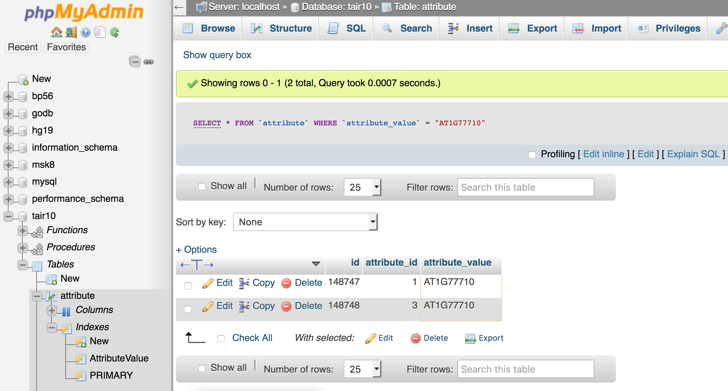

Slide 19
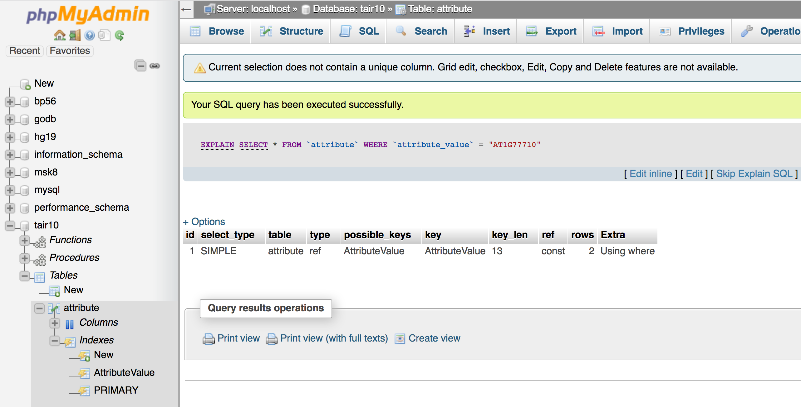

Slide 20
NoSQL – non SQL or non relational
Different types of structures:
Key-value
Wide column
Graph (Neo4J)
Document (MongoDB)
Motivation is that many of the high performance application need databases to perform only selects with very few joins.
Thus there is no need to keep relationships between data objects and there is a lot of repetition, but disk space is cheap.

Slide 21
MongoDB (Document)
http://www.mongodb.org
Data is stored in some standard format, for example JSON/BSON.
No Schemas
No Foreign Keys
https://en.wikipedia.org/wiki/NoSQL

Slide 22
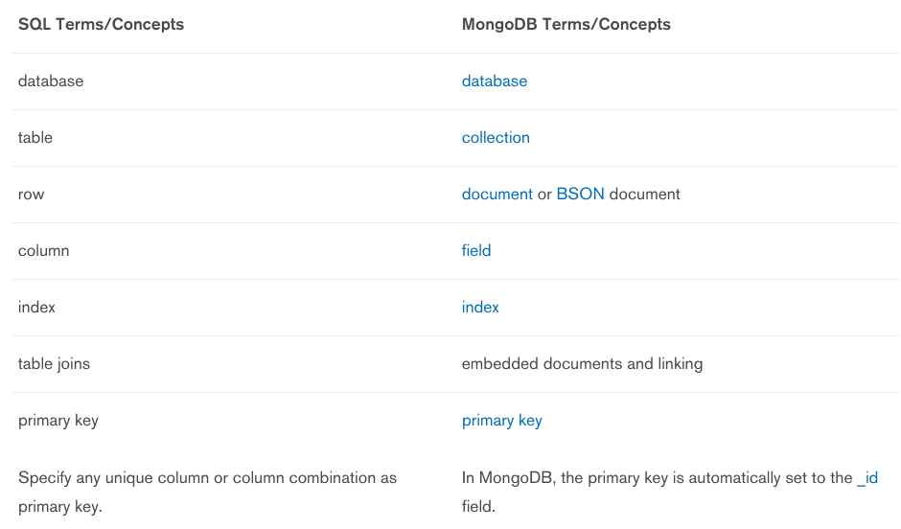
https://docs.mongodb.org/manual/reference/sql-comparison/

Slide 23
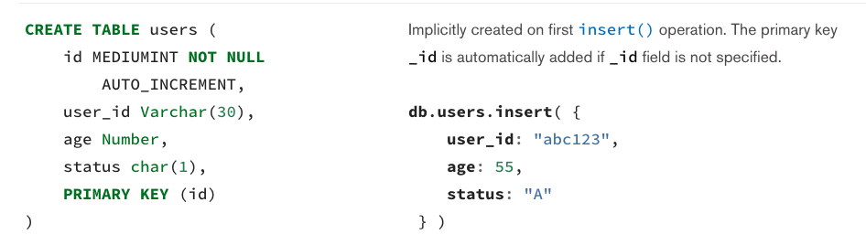
Comparison Examples

Slide 24
